Slide 1

Pod: Salteñas
Group 1:
Evan Cesanek
Daan Wesselink
Akhilesh Kumar
Pasha Zamani
Erjun Zhang
Baby Kumari
TA: Charles I.Saidu
Mentor: Naoki Hiratani
Project TA: Farrokh Karimi
July 2022

Slide 2

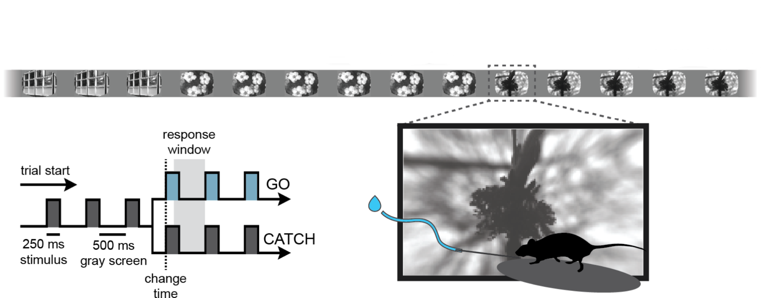
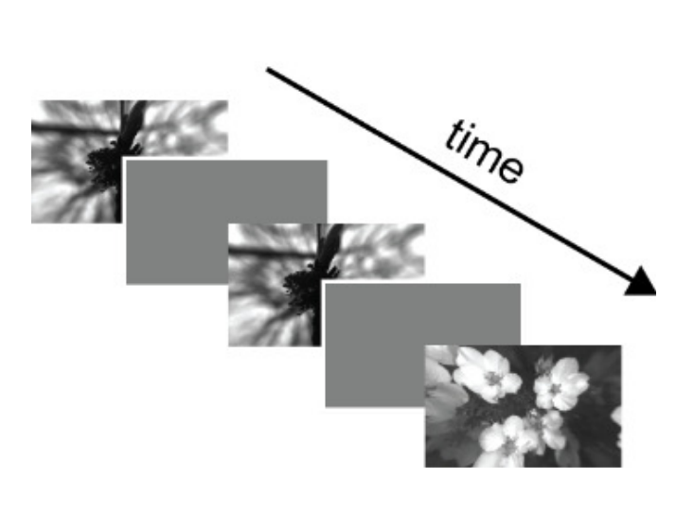
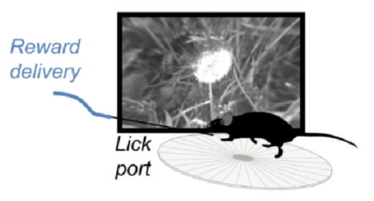
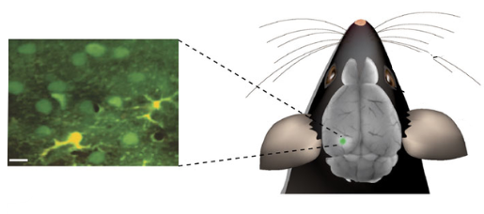
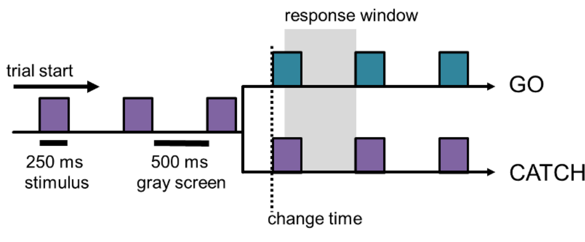
Phenomenon
(8 natural scene images)
Visual change detection task
2-photon Ca⁺² imaging
Mouse visual cortex
Notes:
Baby

Slide 3
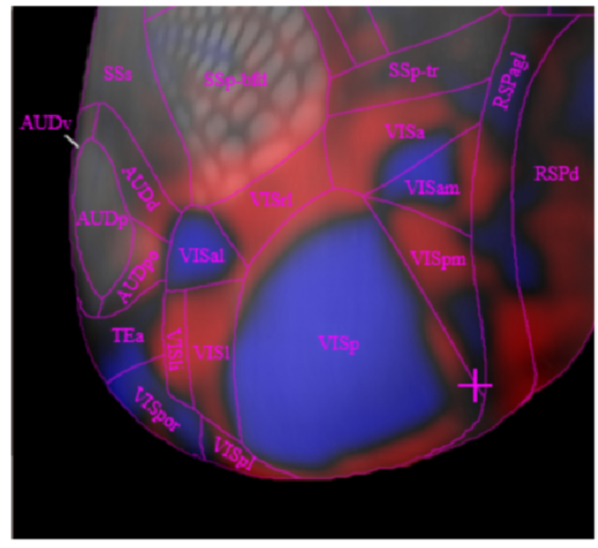
Question
It is shown that excitatory SLC cells in the visual cortex are image selective.
(Garrett, Manavi, et al, 2020)
Do inhibitory neurons of visual cortex (VIP and SST) carry information about the identity of visual stimuli ?
Which neurons encode visual change ?
Notes:
Baby

Slide 4
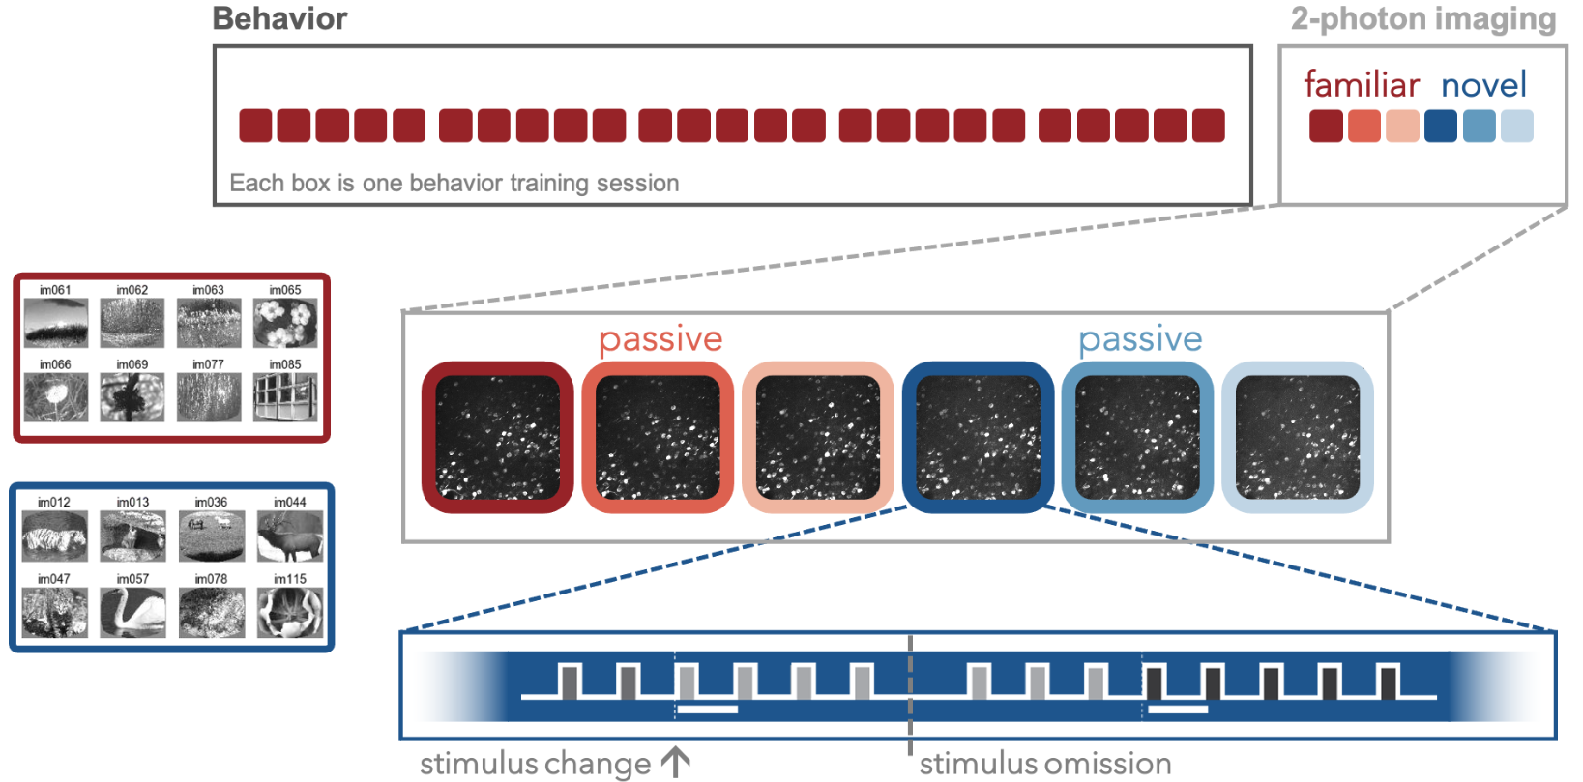
Data
Three visual cell types: SST inhibitory (N=7), VIP inhibitory (N=5), SLC excitatory (N=5)
Two-photon calcium imaging (neural activity = fluorescence change, dF/F)
Mean baseline-corrected activity
Full time-series [-150, 750] ms
Familiar images only
Active and passive viewing

Slide 5
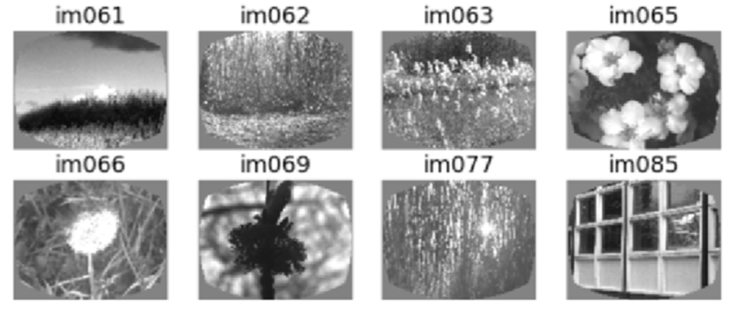
Decoding image identity
Decoder

Slide 6
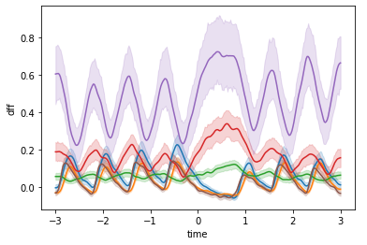
Decoding image identity
Decoder

Slide 7
Decoding image identity
SVM (baseline)
ANN
CNN
Out .
Out .
Train/test
Train/test
Train/test

Slide 8
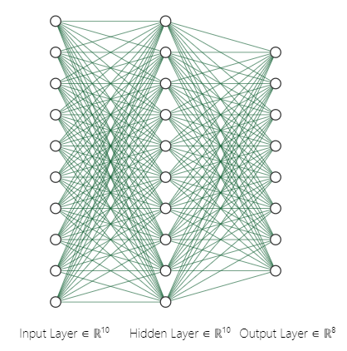

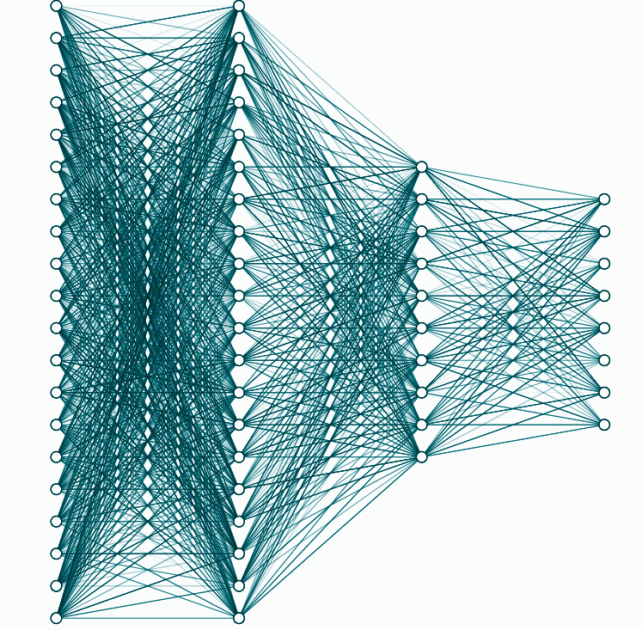
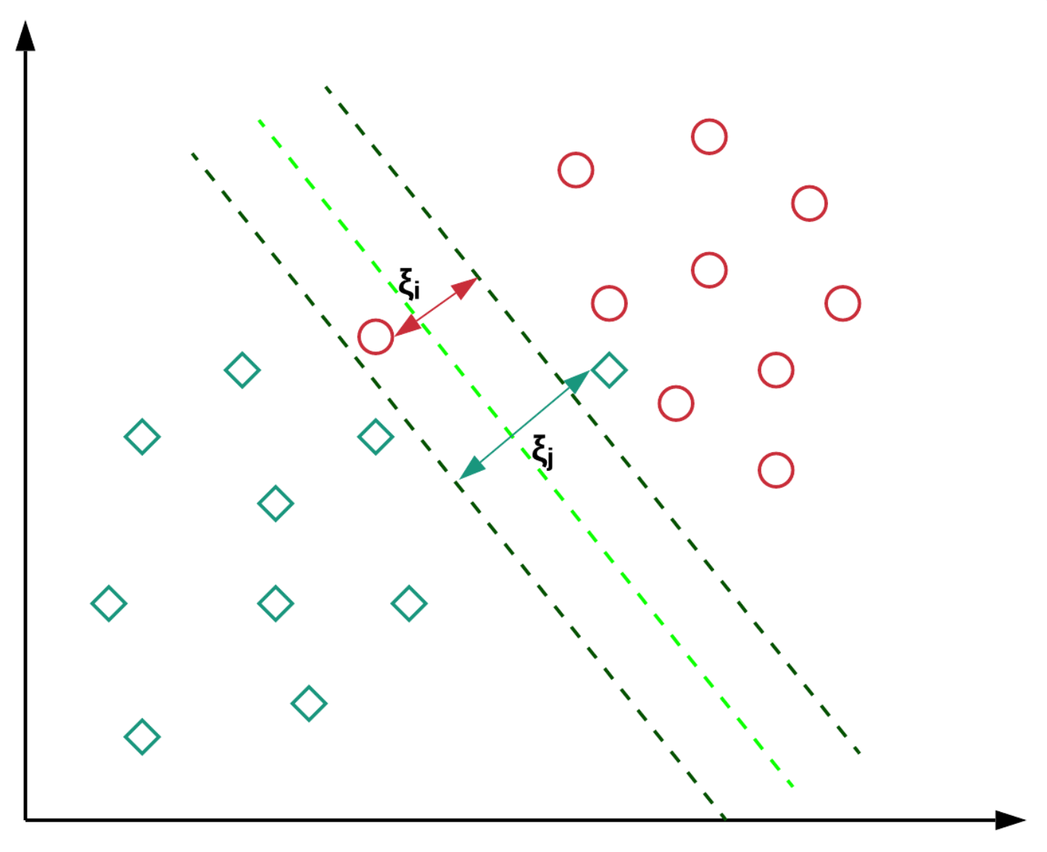
Network architectures
SVM (baseline)
ANN
CNN
FC2 (25, 8)
FC1 (d, 25)
Flatten
(d = 6 * # of cells)
1D Conv +
Average pooling
1D Conv +
Average pooling
1D input
(channels = # of imaged cells)
R¹⁰⁰ R¹⁰⁰ R¹⁰ R⁸

Slide 9
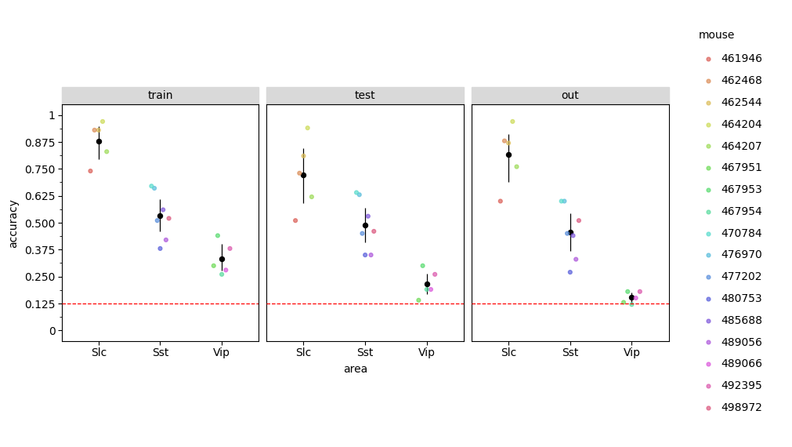
SVM (mean firing rates)

Slide 10
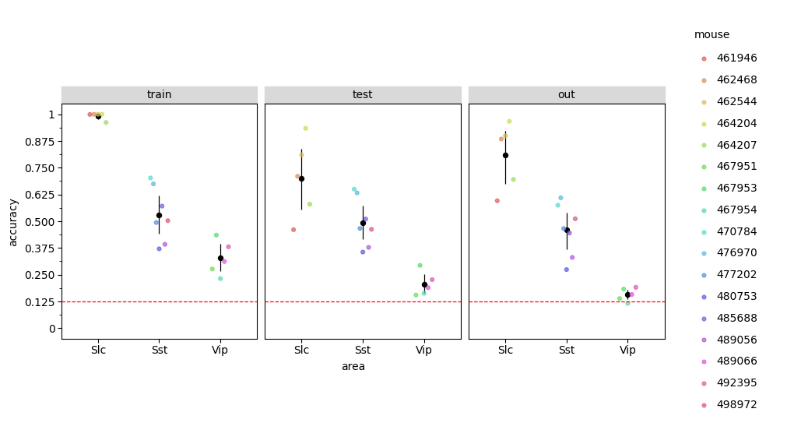
ANN (mean firing rates)

Slide 11
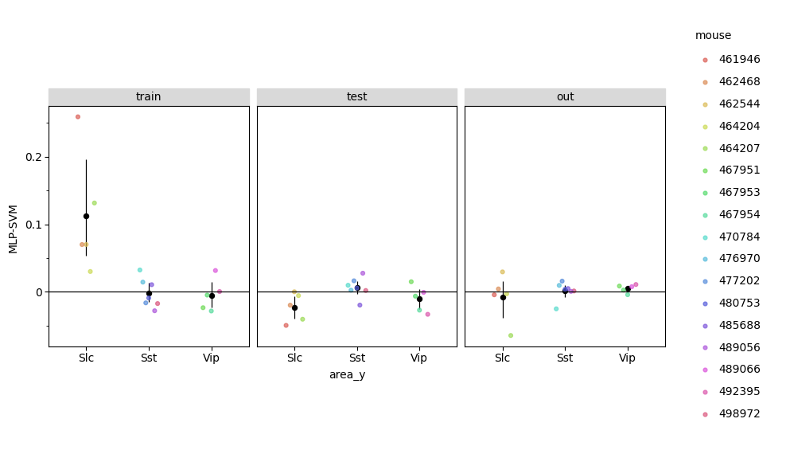
ANN does not outperform SVM

Slide 12
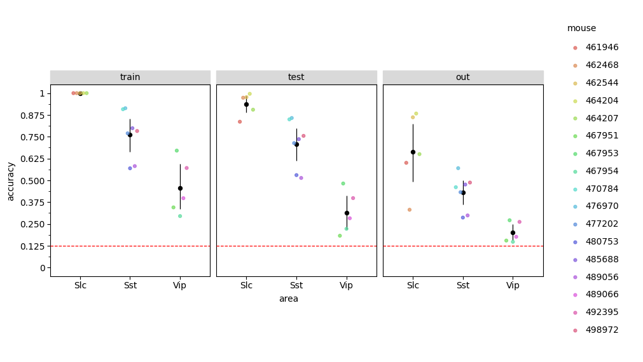
CNN (full time series)

Slide 13
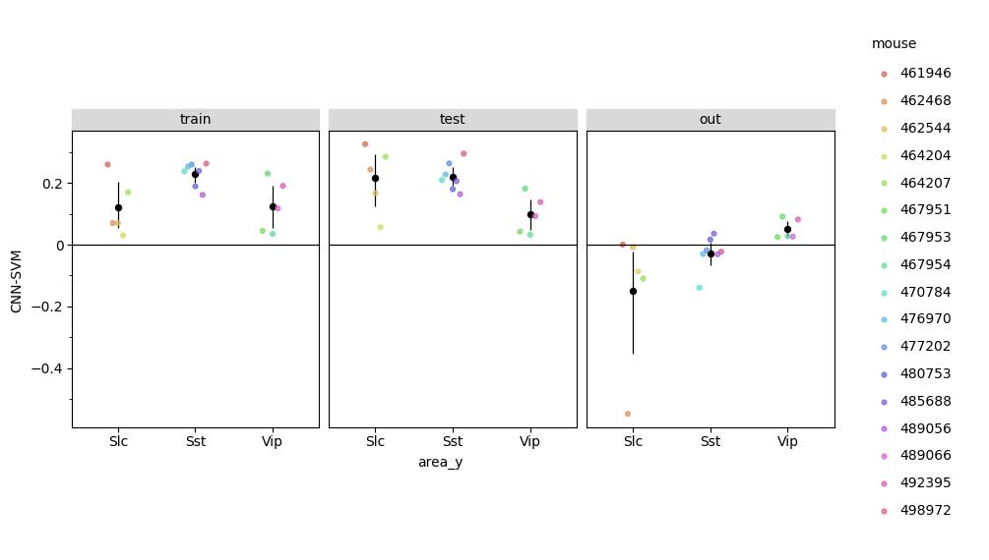
CNN outperforms SVM
(but uses full time series)

Slide 14
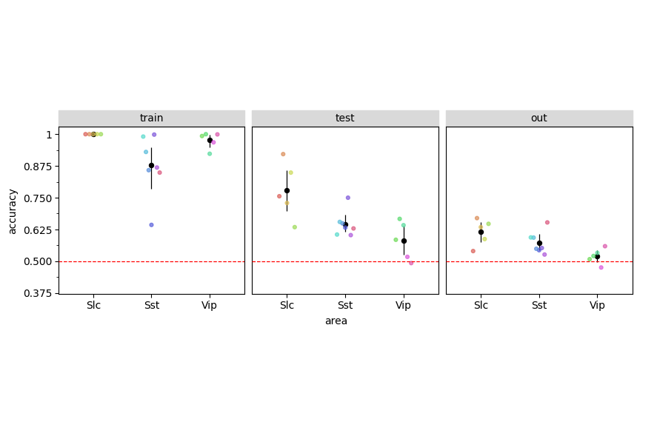
Decoding image-change
ANN
(mean firing rates)
1st vs. 2nd presentation
Active
Active
Passive

Slide 15
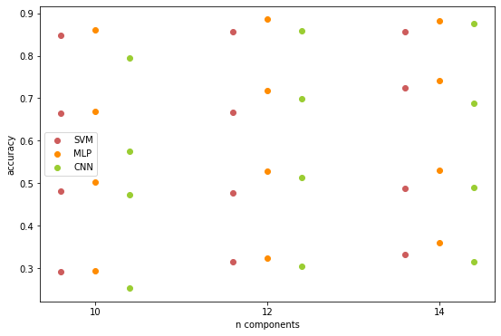
SVM, MLP And CNN (PCA)
Drop constant feature
1
Mouse 1
Normalization
2
Mouse 2
PCA (n=10~15)
Mouse 3
3
Split data (0.8/0.2)
Mouse 4
SVM, MLP, and CNN

Slide 16
Conclusions
Image identity information is encoded in SLC and SST inhibitory neurons (but not in VIP)
CNNs are an effective approach for neural decoding using time-series activity of multiple neurons, where high feature dimensionality can thwart standard machine learning methods
SST decoding performance drops considerably when tested on initial image presentations, suggesting that these neurons may respond differently to image change versus repeated-image recognition
Follow-up analysis shows that SST neurons also encode whether it is the first or second presentation of an image

